Slide 1
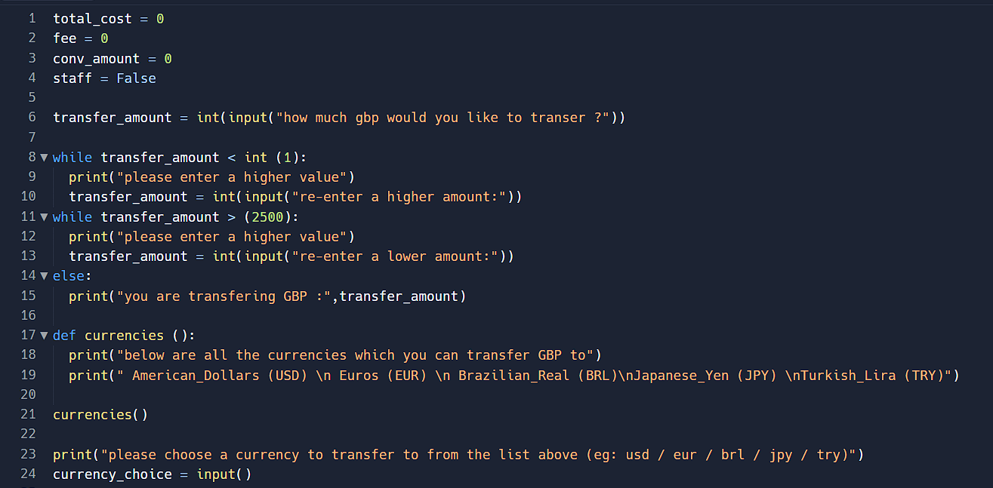

Mohammed mahin ibnay mamun (346584) unit 4 group 1 2019 mock 0 currency exchange python code

Slide 2
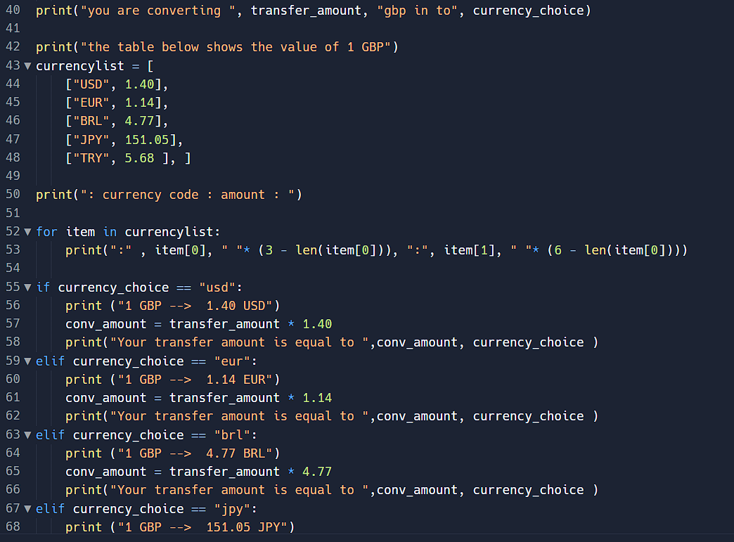


Slide 3
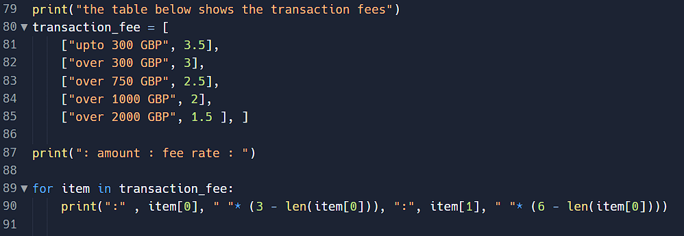
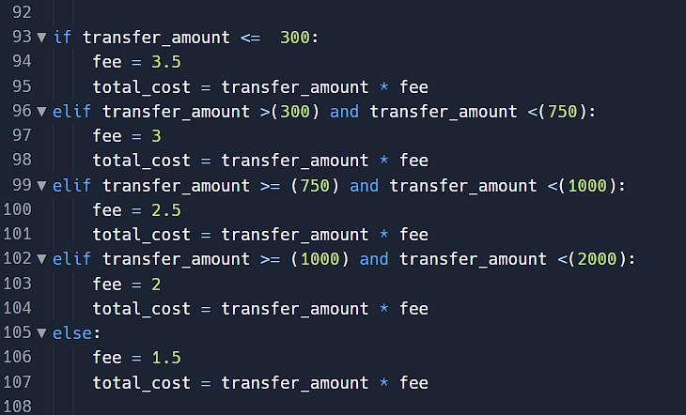

Slide 4
